Slide 1

DEEP Learning using keras
Neeraj Chavan
Prasad Tambe
Jay Dave
Bharat Jethwani
Kinjal Maru
Ayush Jain

Slide 2

Introduction
“The question of whether a computer can think is no more interesting than the question of whether a submarine can swim.”
― Edsger W. Dijkstra

Slide 3
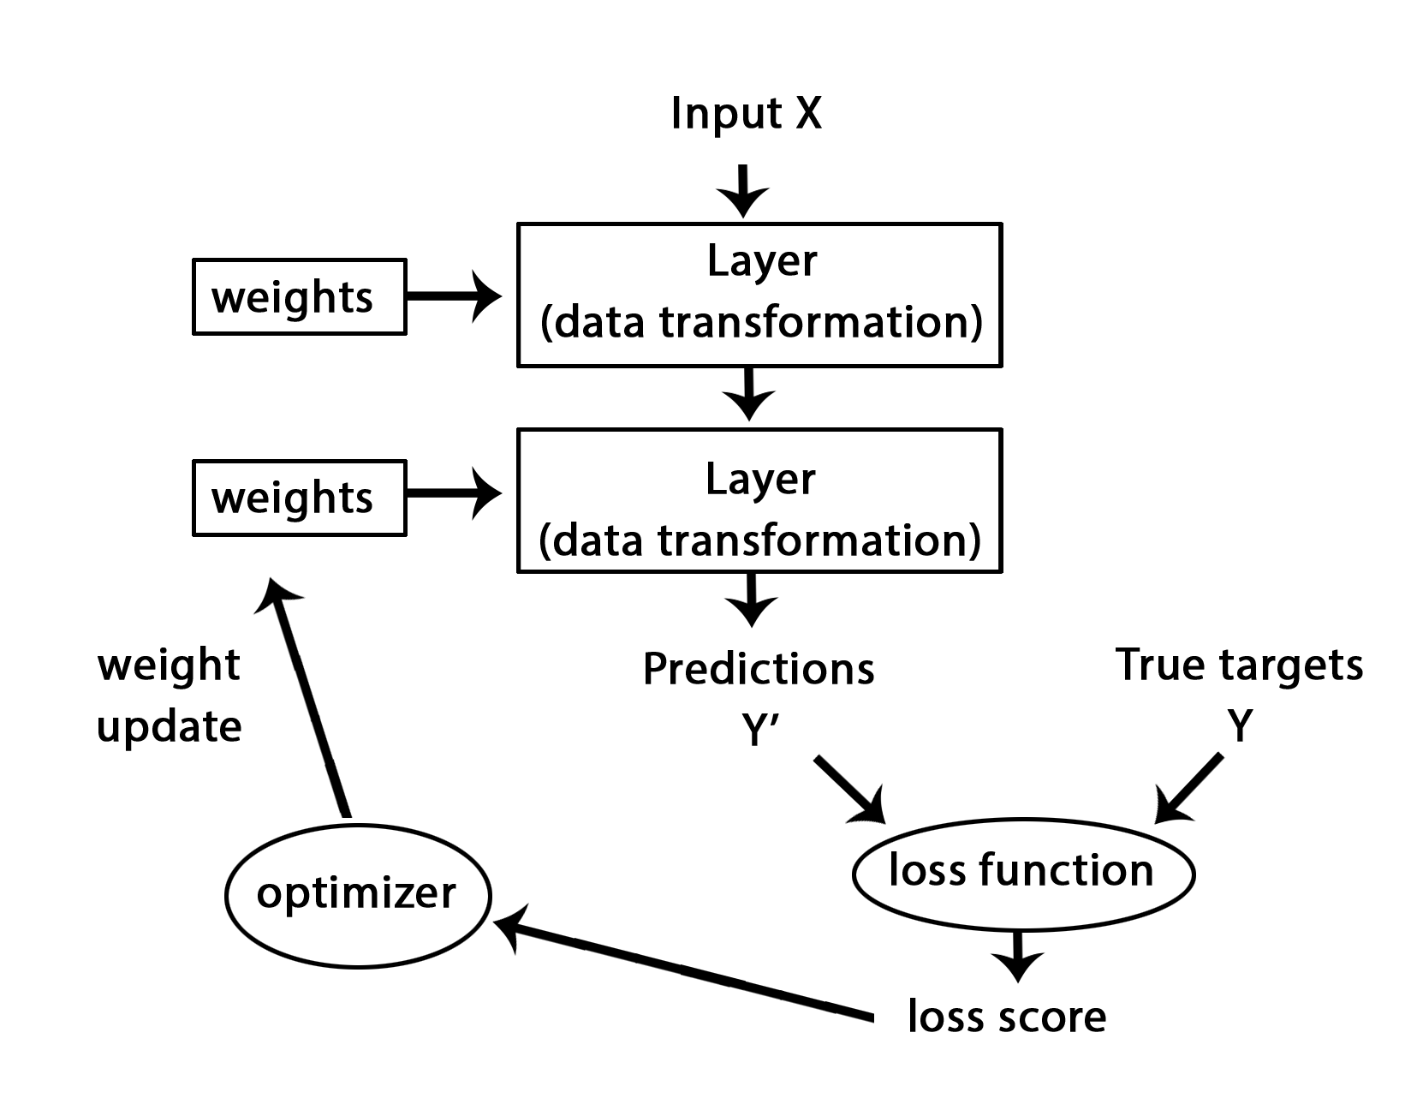
What is Deep Learning?
Input to output to via layers of representation
Like a function transforming Input to output
One hidden layer- A neural network
More than one hidden layer – A “deep” neural network

Slide 4
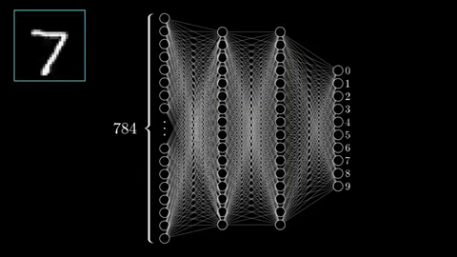
Understanding Neural Networks
Neural networks are used when you want to recognize patterns. (Supervised learning)
They are simplified models of brains.
Neurons are either activated or inactivated based on the synapses(weights), which connect the neurons together & determine its state
The neurons are arranged in layers - An input layer, one or more "hidden" layers and an output layer

Slide 5
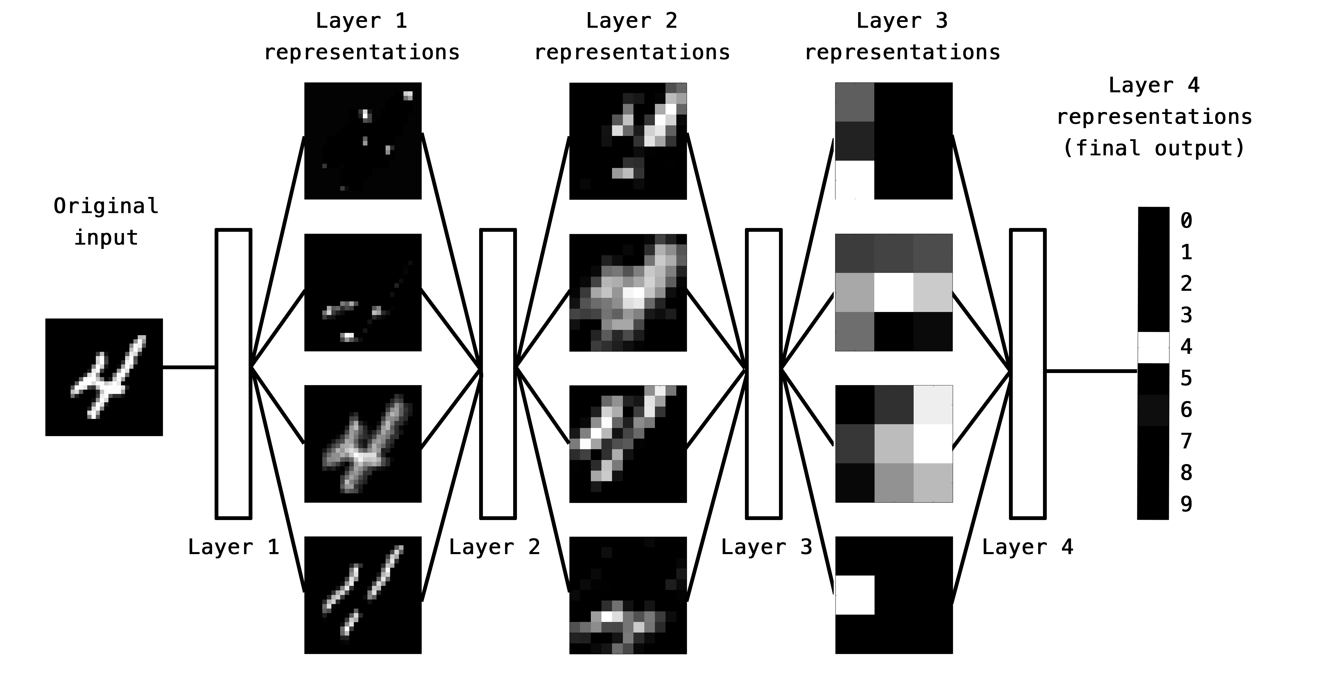
What Are Layers?
Raw Data
Data Transformation
Useful Information
Data transformation functions parametrized by weights
Weights and biases determine the behavior of the layer
An information distillation pipeline
Complex geometric transformations broken down into simpler ones
e.g. Turning a crumpled ball of paper into an uncrumpled one

Slide 6
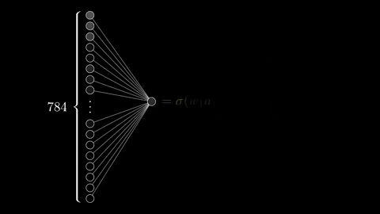
What determines the output of a layer?
The outputs from the input layer are fed as inputs to the first layer
A bias is added along with the weight to the successive layer
The output of layers are determined as a function of these weights and biases

Slide 7
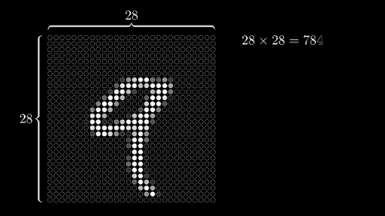
Activation of Neurons in a layer
The value in the neurons is between 0 and 1
An activated neuron or pixel will have the value 1 (brightest pixel) and the dark pixels will have the value 0

Slide 8
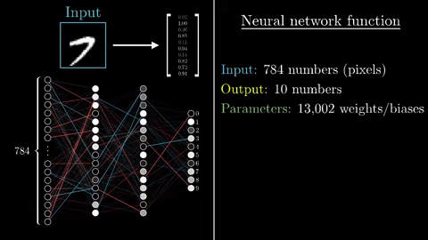
What Exactly is Cost function?

Slide 9
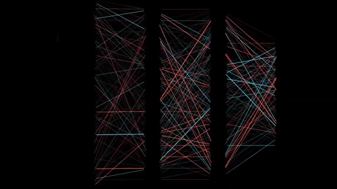
Backpropagation Algorithm
We need to reduce the cost function for improving model accuracy
For this, loss is used as a feedback signal to an optimizer to iteratively adjust the model performance (by adjusting weights and biases)
Training or Fitting consists of finding batches of data to training process, to learn the optimal model parameters by nudging the weights and biases

Slide 10
Keras Overview
Keras is a high-level neural networks API, written in Python and capable of running on top of TensorFlow, CNTK, or Theano
Allows for easy and fast prototyping (through user friendliness, modularity, and extensibility).
Supports both convolutional networks and recurrent networks, as well as combinations of the two.
Runs seamlessly on CPU and GPU.
Keras (κέρας) means horn in Greek
Initially developed as part of the research effort of project ONEIROS (Open-ended Neuro-Electronic Intelligent Robot Operating System)

Slide 11
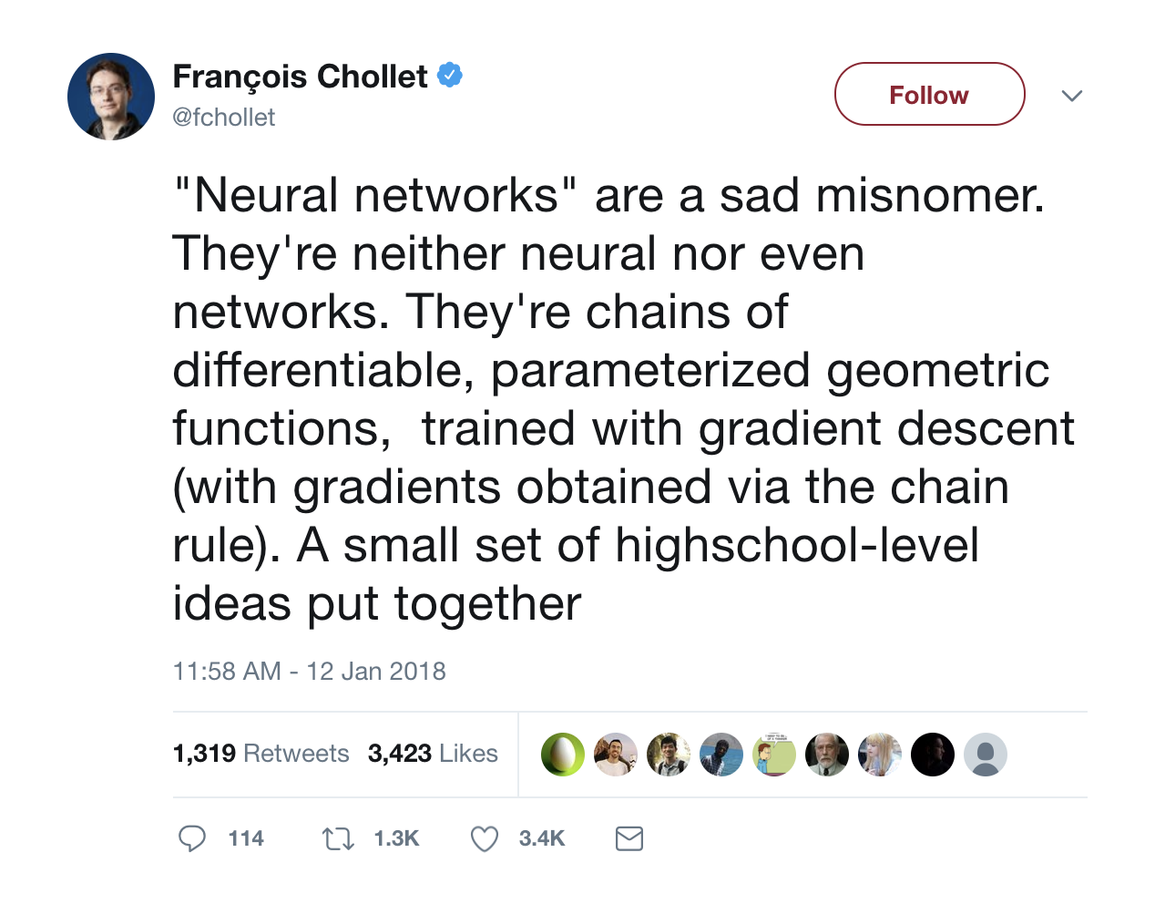
Let’s Summarise!
Installation
Pre-Processing
Building and Compiling
Fitting & Evaluating
Predictions and Applications

Slide 12
Installation Of Keras on R-Studio
Install Anaconda (for Python set-up)
Keras interface uses Tensorflow backend engine by default (both installations are supported i.e Keras and Tensorflow)
SYNTAX:
Library(keras)
install_keras()
For a more customised installation (Installing Keras on GPU)
install_tensorflow(tensorflow=“GPU”)

Slide 13
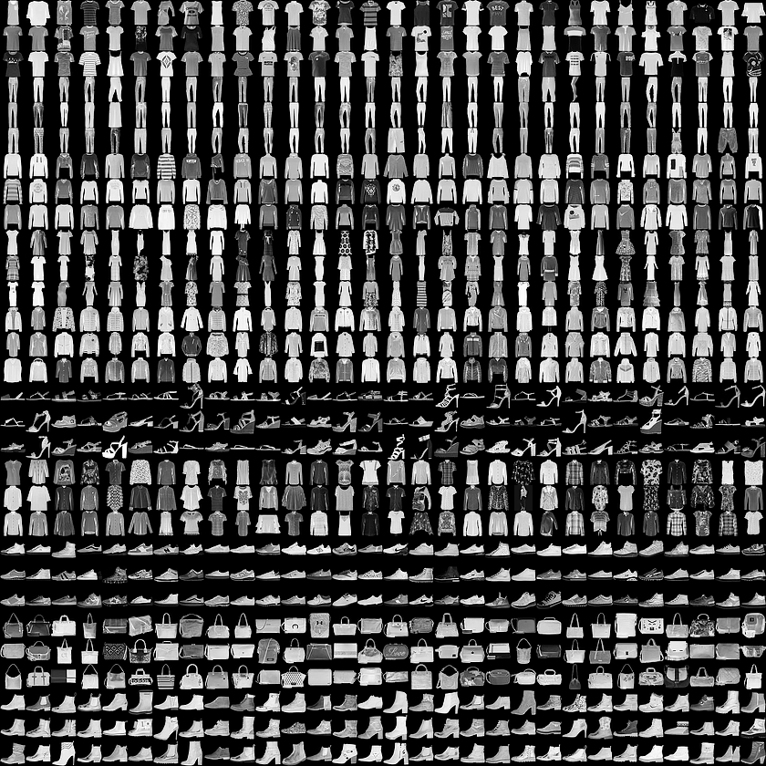
Importing the Fashion-mnist dATASET
This dataset contains 70000 grayscale images in 10 categories
This image shows individual articles of clothing at low resolution (28*28 pixels)
MNIST dataset contains of handwritten digits(0,1,2,3..). identical to the article of clothing, as seen in the adjacent picture

Slide 14
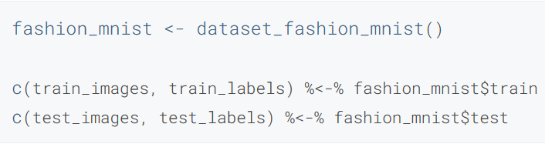
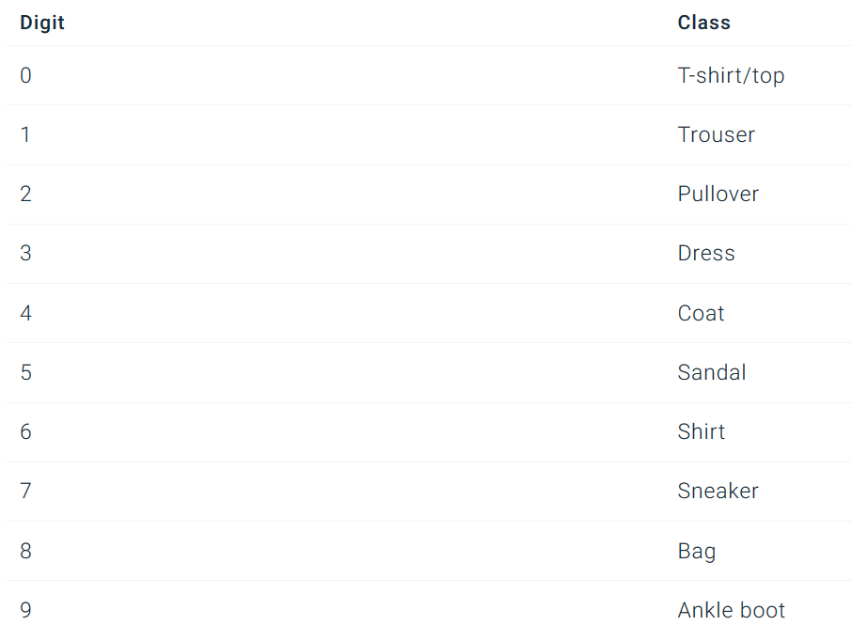
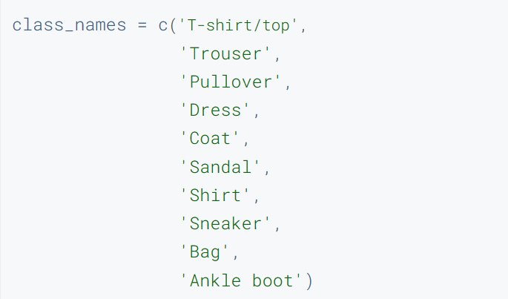
Loading the Dataset in r-studio

Slide 15
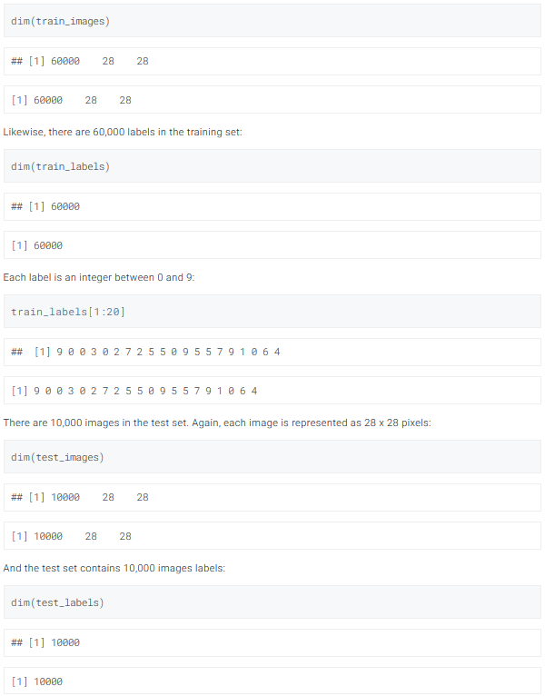
Exploring The DataSet
Formatting the dataset before training the model

Slide 16
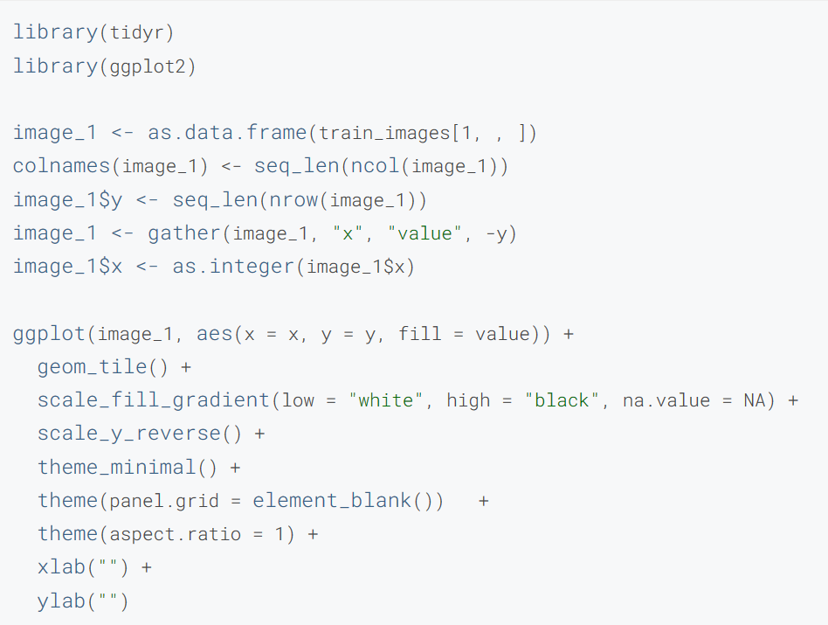
Data Pre-Processing & WHY WE NEED IT?
We transform input data to tensors before we feed it into a model
We scale these values to a range of 0 to 1 before feeding to the neural network model (divide by 255)
We display the first 25 images from the training set and display the class name below each image for verification

Slide 17
Predictive Data Analytics

Slide 18
Keras Structure

Slide 19
Layers Explanation

Slide 20
Set Up Model

Slide 21
WHAT IS MODEL FITTING
Measure of how well a model generalizes to similar data to that on which it was trained
Well-fitted - accurate outcomes
Over fitted - matches the data too closely
Under fitted - doesn’t match data closely enough

Slide 22
Function of keras model
.fit()
.fit_generator()
.train_on_batch()

Slide 23
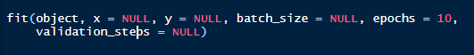
Description:
Train a Keras model for a fixed number of epochs
Syntax : -
Object - Keras model object
X – training data
Y- target data
epochs - Number of times to iterate over the training data arrays.
batch_size - number of samples that going to be propagated through the network
validation_steps - Total number of steps to validate before stopping.
.fit() function

Slide 24
Description:
Fits The Model On Data Yielded Batch-By-Batch By A Generator.
Syntax: -
Object - Keras model object
steps_per_epoch - batches of samples to yield from generator
.fit_generator() function

Slide 25
.train_on_batch function
Description:
Single gradient update or model evaluation over one batch of samples
Syntax: -
Class_weight - named list mapping classes to a weight value, used for scaling the loss function (during training only).
sample_weight - array of weights for the training samples, used for weighting the loss function

Slide 26
Fit() | Fit_generator()
Works on small Dataset | Works on large Dataset
Does not require generator function | Calls generator function for operation
Difference between .fit & .fit_generator

Slide 27
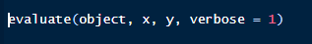
EVALUATE ACCURACY
Description:
Compare how the model performs on the test dataset:
Syntax :
Verbose - Verbosity mode (0 = silent, 1 = verbose, 2 = one log line per epoch).

Slide 28

Pre
Prediction

Slide 29
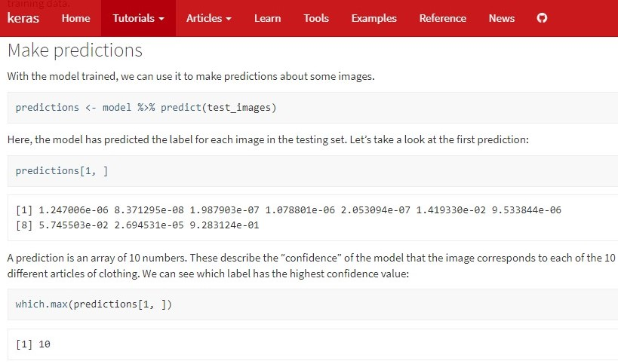
Making predictions:
Method 1

Slide 30
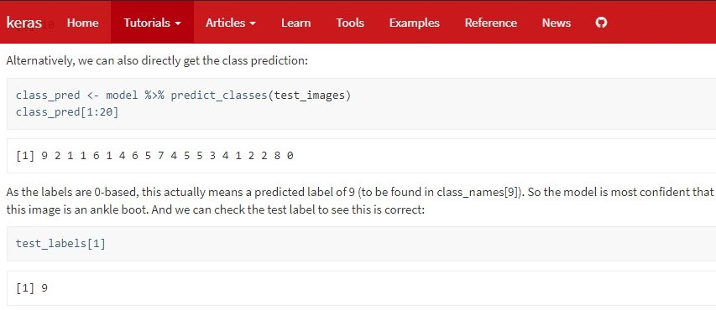
Making predictions:
Method 2

Slide 31
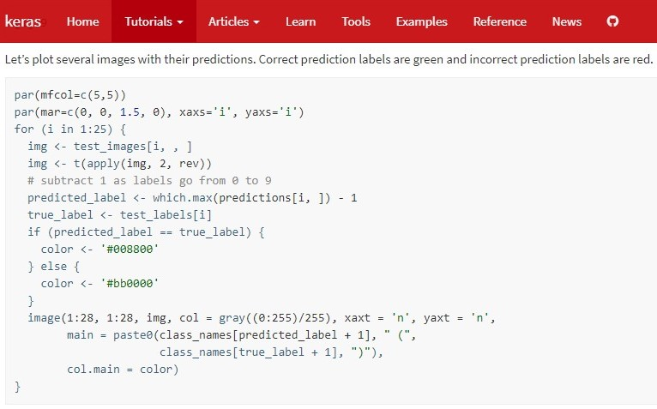
Plotting predictions

Slide 32
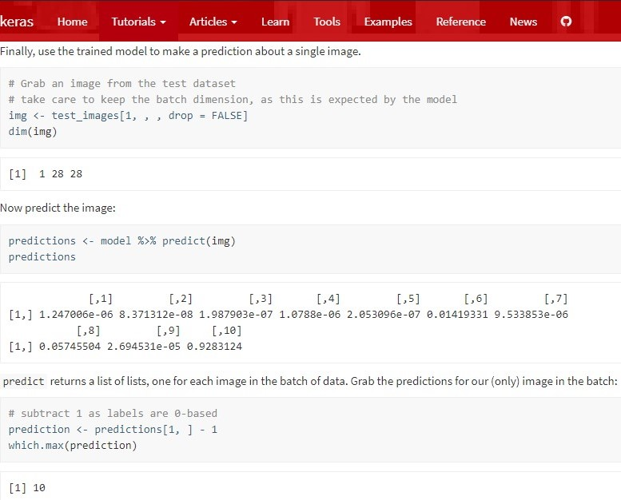
Plotting predictions
cont..

Slide 33
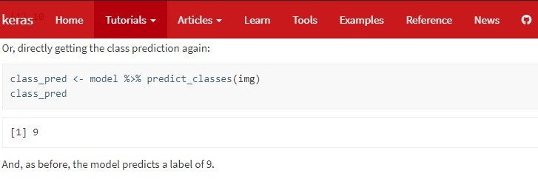
Plotting predictions
End.

Slide 34



BUILDING AND COMPILING YOUR MODEL

Slide 35
BUILDING AND COMPILING YOUR MODEL
Lets have a quick recap

Slide 36
Quick Recap
Introduction to keras
Installations of keras
Importing Fashion MNIST dataset
Exploring the data
Preprocessing the Data
Build the model
Setup layers
Compile the model
Train the model
Evaluate accuracy
Make predictions

Slide 37

And if you still don't get it

Slide 38
Future scope

Slide 39
Advantages of
Deep Learning
Artificial intelligence is growing exponentially. There is no doubt about that. Self-driving cars are clocking up millions of miles, IBM Watson is diagnosing patients better than armies of doctors and Google Deepmind's AlphaGo beat the World champion at Go - a game where intuition plays a key role.
But the further AI advances, the more complex become the problems it needs to solve. And only Deep Learning can solve such complex problems and that's why it's at the heart of Artificial intelligence and Data Science.

Slide 40
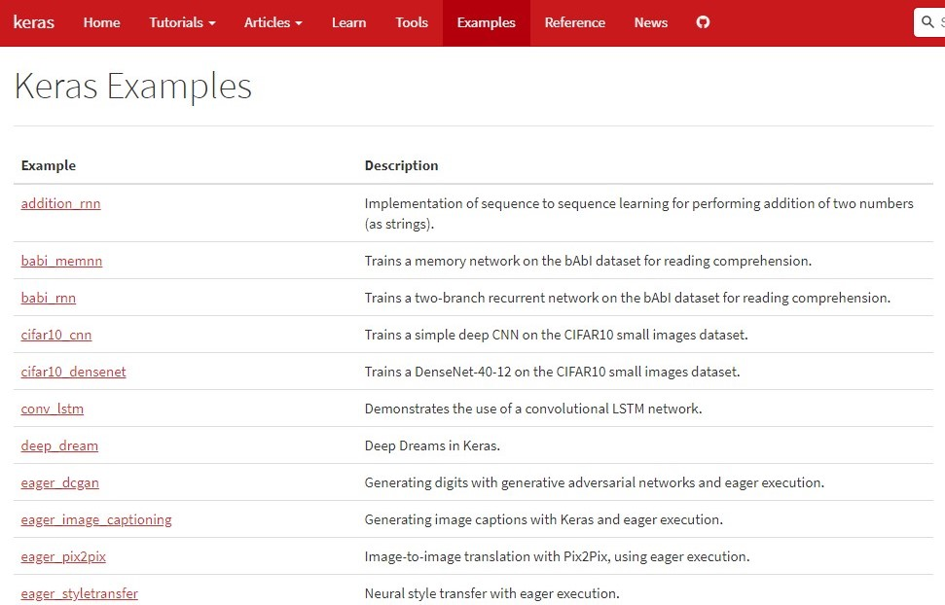
Examples on Keras

Slide 41


